Slide 1
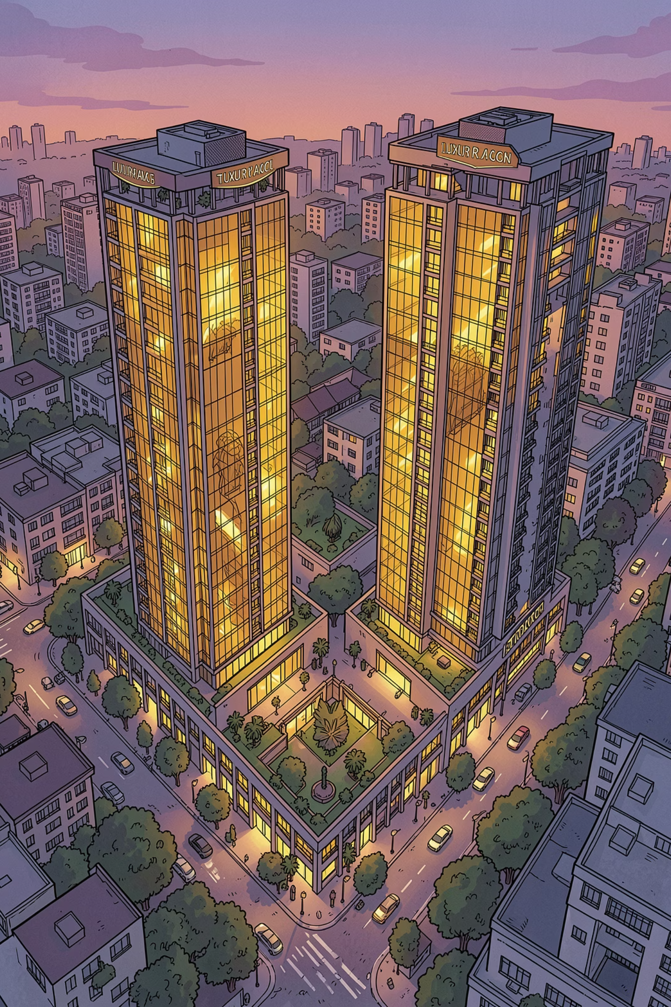
India Exclusive Brand Representation Platform
Connecting world-class international brands with India's most ambitious branded real estate opportunities across India's most dynamic cities.

Slide 2
The Big Picture
Executive Summary
India is rapidly emerging as one of the world's fastest-growing branded residence markets. Branded homes are redefining luxury across Indian cities, with India now accounting for 4% of global branded residences — placing it among the world's top 6 markets. This trend mirrors the rise of a new generation of affluent homebuyers who seek not just a home, but a lifestyle backed by global brand trust.
A ₹22,800 Cr Market
Nationwide Phenomenon
Our Platform
The branded residence segment in India is already valued at over ₹22,800 crore and growing at double-digit CAGR across all key metrics.
Supply and interest are no longer restricted to one or two metros. Branded living is a nationwide movement driven by changing buyer aspirations.
We propose a dedicated India platform to represent international brands and structure branded real estate opportunities with precision and local expertise.

Slide 3
The Investment Case
Beyond the Brochure: What the Data Suggests
The numbers tell a compelling story. Across every measurable dimension — supply, project count, market value, and niche categories — branded residences in India are outpacing traditional real estate growth. This is not a short-term spike; it is a structural shift in how affluent Indians choose to live and invest.
12–18%
15–20%
Unit Supply CAGR
Project Count CAGR
Branded residence unit supply is expanding rapidly, reflecting growing developer and brand confidence in the segment.
The number of branded projects launching annually is accelerating across metro and emerging cities alike.
18–25%
25%+
Market Value CAGR
Wellness Segment CAGR
Total market value growth outpaces unit supply, indicating strong premium pricing and demand dynamics.
Wellness-branded and senior-living residences are the fastest-growing niches, with 20–30% CAGR in senior living alone.

Slide 4
MARKET OPPORTUNITY
India Among the World's Leading Branded Residence Markets
4%
30–40%
₹22,800Cr
Global Share
Price Premium
Market Value
India's share of global branded residences, placing it in the top six markets worldwide.
Branded homes command significantly higher prices compared to equivalent non-branded properties.
The branded residence segment in India is already valued at over ₹22,800 crore.
Branded homes benefit from stronger absorption rates and superior resale values — a compelling proposition for developers and investors alike.

Slide 5
The Opportunity
India's Branded Residence Market: A ₹1 Lakh Crore Opportunity by 2035
The branded residence segment in India is already valued at over ₹22,800 crore and growing at 18–25% CAGR. With India's luxury consumer base expanding rapidly and branded homes commanding 30–40% premiums, the market is projected to cross ₹1 lakh crore by 2030. This is a generational opportunity for international brands to establish a dominant presence in one of the world's most dynamic real estate markets.
₹22,800Cr
18–25%
₹1L Cr
Current Market Size
Annual Growth Rate
2035 Projection
India's branded residence segment is already valued at over ₹22,800 crore today.
Market value is growing at 18–25% CAGR, outpacing most global branded residence markets.
The market is expected to cross ₹1 lakh crore by 2035, driven by rising affluence and brand consciousness.
India's branded residence market represents a rare convergence of demographic momentum, rising affluence, and brand aspiration. For international brands with the right local partner, this is the decade to establish a defining presence in India.

Slide 6




Market Opportunity
India Among the World's Leading Branded Residence Markets
The Premium Advantage
Why Brands Win
Branded homes in India command 30–40% price premiums over comparable non-branded properties in the same locations. This premium is not merely aspirational — it is backed by stronger absorption rates, faster sales velocity, and demonstrably better resale values. For developers and brand partners, this represents a significant margin opportunity that traditional projects simply cannot match.
The combination of brand trust, hospitality-grade amenities, and professional management creates a product that resonates deeply with India's growing cohort of high-net-worth individuals, NRIs, and global executives.
Stronger absorption — branded projects sell faster than unbranded comparables
Higher resale values — brand legacy sustains long-term property appreciation
Premium tenant profile — attracts expats, CXOs, and diplomatic households
Global brand equity — international recognition drives buyer confidence

Slide 7
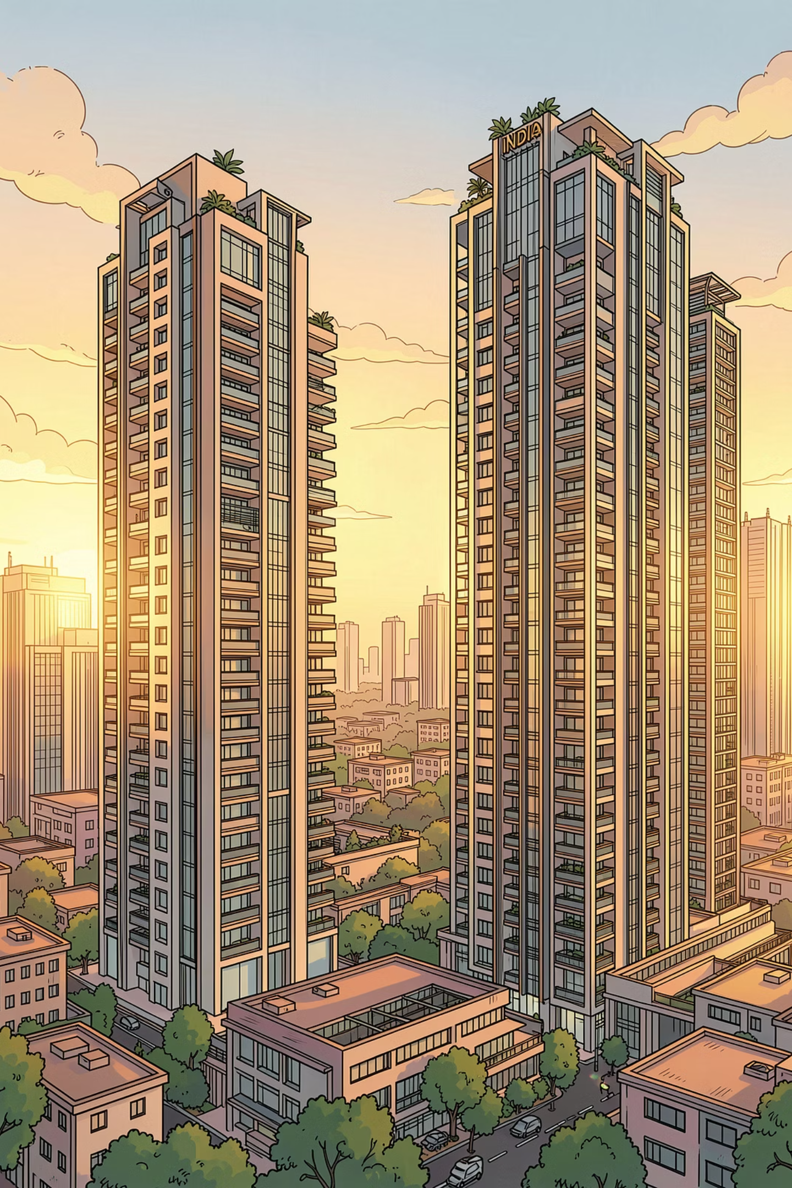
MARKET CONTEXT
Why India, Why Now?
Rising HNWIs
India's high-net-worth population is expanding rapidly, creating a deepening pool of luxury-ready buyers.
Luxury Appetite
Growing demand for curated lifestyle experiences is reshaping what affluent buyers expect from their homes.
Global Exposure
Internationally travelled buyers are bringing global standards and brand expectations back to India.
Developer Interest
Leading Indian developers are actively seeking international brand partnerships to elevate their projects.

Slide 8




The Investment Case
Four Reasons Branded Residences Outperform
Beyond aspirational appeal, branded residences offer measurable financial advantages that appeal to both end-users and investors. From rental yields to risk mitigation, the investment thesis is backed by data and market behavior across India's key cities.
1
2
Higher Rental Yields
Better Resale Value
Branded homes attract premium tenants — expats, diplomats, CXOs, and business families — who are willing to pay significantly more for comfort, convenience, and brand association. In many cities, these homes command 20–30% higher rents compared to similarly sized non-branded properties in the same neighborhood, delivering superior long-term yield for investors.
Homes backed by a global brand's legacy and upkeep standards tend to retain their appeal longer. Resale becomes easier, and in many cases, these properties appreciate faster because demand consistently outpaces supply. When selling a branded residence, you are not just selling brick and mortar — you are selling trust, lifestyle, and community.
3
4
Lower Developer Risk
Professional Property Management
Buyers in traditional projects frequently worry about post-handover service gaps, construction quality, and delays. In branded residences, the international partner has a reputation to uphold — which typically entails stricter deadlines, superior quality control, and more accountable management. For buyers and investors, that significantly reduces execution risk.
Many branded homes come with ongoing property management services — often provided by the brand's hospitality arm. Whether you live there or rent it out, your home is cared for like a hotel suite. Landscaping, maintenance, concierge services, and security are all part of the package — a significant advantage for NRIs and passive investors.

Slide 9




Industry Trends
Global Brands Are Entering Real Estate — India Is Next
Across the world, the most recognisable names in fashion, automotive, hospitality, wellness, and entertainment are extending their brand equity into residential real estate. India, with its rapidly growing affluent class and increasing appetite for lifestyle-led living, is the natural next frontier. The question for international brands is no longer whether to enter India's branded residence market — but how to do it with the right partner.
Fashion Houses
Automotive Brands
Luxury fashion brands are translating their design language into residential experiences, offering buyers a curated lifestyle environment.
Prestige automotive marques are bringing their engineering precision and performance ethos to branded residential towers.
Hospitality Brands
Wellness Operators
Global hotel operators are the most established players, offering residence-linked services, management, and brand recognition.
Wellness and lifestyle brands are entering the segment, responding to India's growing health-conscious affluent demographic.

Slide 10
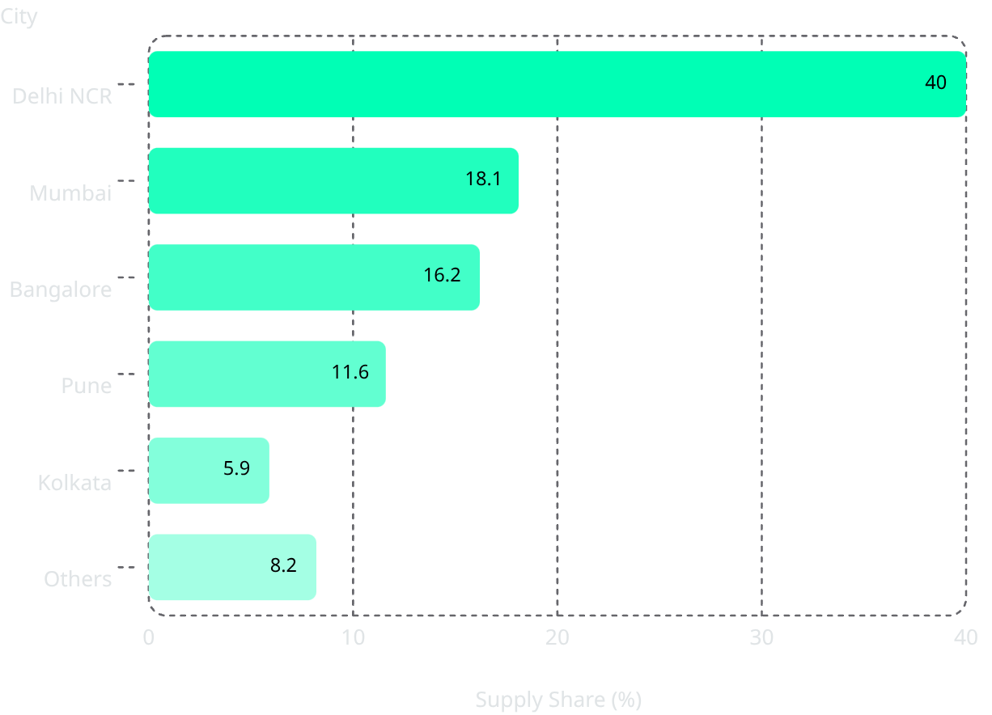





Mapping the Market
A Nationwide Phenomenon: Where Branded Living Is Taking Root
Branded residence supply is no longer confined to one or two metros. Delhi NCR leads with over 40% of national supply, anchored by Gurugram, Noida, and Delhi's ultra-luxury corridors — driven by proximity to international airports, MNCs, and a sizable expat population. Mumbai accounts for 18.1%, where land scarcity and vertical density make branded homes especially desirable for their privacy, views, and maintenance guarantees.
Key Insights
Delhi NCR — Over 40% of supply, driven by Gurugram and Noida's MNC and expat corridors
Mumbai — 18.1% share; land scarcity makes branded homes a premium necessity
Bangalore — 16.2%, fueled by tech wealth and globally travelled professionals. Driven by a booming tech economy and globally travelled professionals. Developers are partnering with international hospitality brands beyond CBDs.
Pune — 11.6%, attracting younger HNIs seeking comfort and character.
Younger HNIs drawn by startup culture, elite institutions, and proximity to Mumbai are redefining what luxury means beyond the big metros.
Kolkata — 5.9%, signaling deeper behavioral change in Tier-1.5 cities. A signal of deeper behavioural change — wealthy buyers in Tier-1.5 cities now demand prestige, design sensibility, and service, not just location.
Emerging corridors include Hyderabad, Goa, Chandigarh, Ahmedabad, Jaipur, and Rishikesh.

Slide 11
The Challenge
Why Global Brands Struggle to Enter India
India's branded residence opportunity is enormous — but so is its complexity. For international brands accustomed to structured markets, India presents a unique set of barriers that require deep local knowledge, trusted relationships, and on-the-ground execution capability. Without the right partner, even the most prestigious brands can find themselves navigating a fragmented and unpredictable landscape.
Barriers to Entry
Execution Gaps
1
Fragmented Developers
1
Inconsistent Execution
India's developer ecosystem is highly fragmented, with varying levels of quality, financial discipline, and brand alignment. Identifying the right development partner requires deep local market intelligence.
Even with the right developer, maintaining global brand standards across design, construction, and delivery is a persistent challenge in India's varied execution environment.
2
Regulatory Challenges
2
Limited Local Oversight
Navigating India's regulatory environment — from FDI norms to RERA compliance, land titles, and local approvals — demands specialized legal and operational expertise that most international brands do not possess in-house.
International brands often lack the on-ground presence needed to monitor quality, manage stakeholder relationships, and respond to issues in real time — creating reputational risk.

Slide 12




Our Solution
Our Platform: The Bridge Between Global Brands and India
We solve the India complexity problem for international brands. Our platform is purpose-built to handle every layer of market entry — from identifying the right developer partners to managing regulatory compliance, ensuring quality execution, and providing continuous local oversight. We are the trusted local partner that global brands need to unlock India's branded residence opportunity with confidence.
Developer Curation
Regulatory Navigation
We identify and vet developers with the financial strength, track record, and brand alignment required to deliver at global standards.
Our team manages FDI structures, RERA compliance, land due diligence, and local approvals — so brands can focus on what they do best.
Quality Oversight
Local Presence
We provide on-ground brand guardianship throughout design, construction, and delivery — ensuring global standards are never compromised.
With deep relationships across India's real estate ecosystem, we offer the local intelligence and responsiveness that international brands need to operate effectively.

Slide 13


THE INVESTMENT CASE
Lower Risk, Higher Confidence
Reduced Developer Risk
Professional Property Management
International brand partners bring stringent deadlines, superior quality control, and accountable management structures — significantly reducing buyer anxiety around delays and construction quality.
Many branded homes include ongoing management by the brand's hospitality arm — landscaping, maintenance, concierge, and security. Ideal for NRIs and passive investors seeking hands-off ownership.

Slide 14
OUR SOLUTION
Exclusive India Representation: End-to-End
A single, trusted partner managing every phase of market entry and brand governance in India.
01
02
Strategy & Intelligence
Developer Sourcing & Due Diligence
Market research, brand positioning, and entry strategy.
Identifying, vetting, and qualifying the right development partners.
03
04
Negotiations & Licensing
Compliance & Brand Governance
Deal structuring, agreements, and legal coordination.
Ongoing oversight, deviation alerts, and corrective actions.
05
Overall end to end supervision, red flags, proactive solutions for smooth execution.

Slide 15
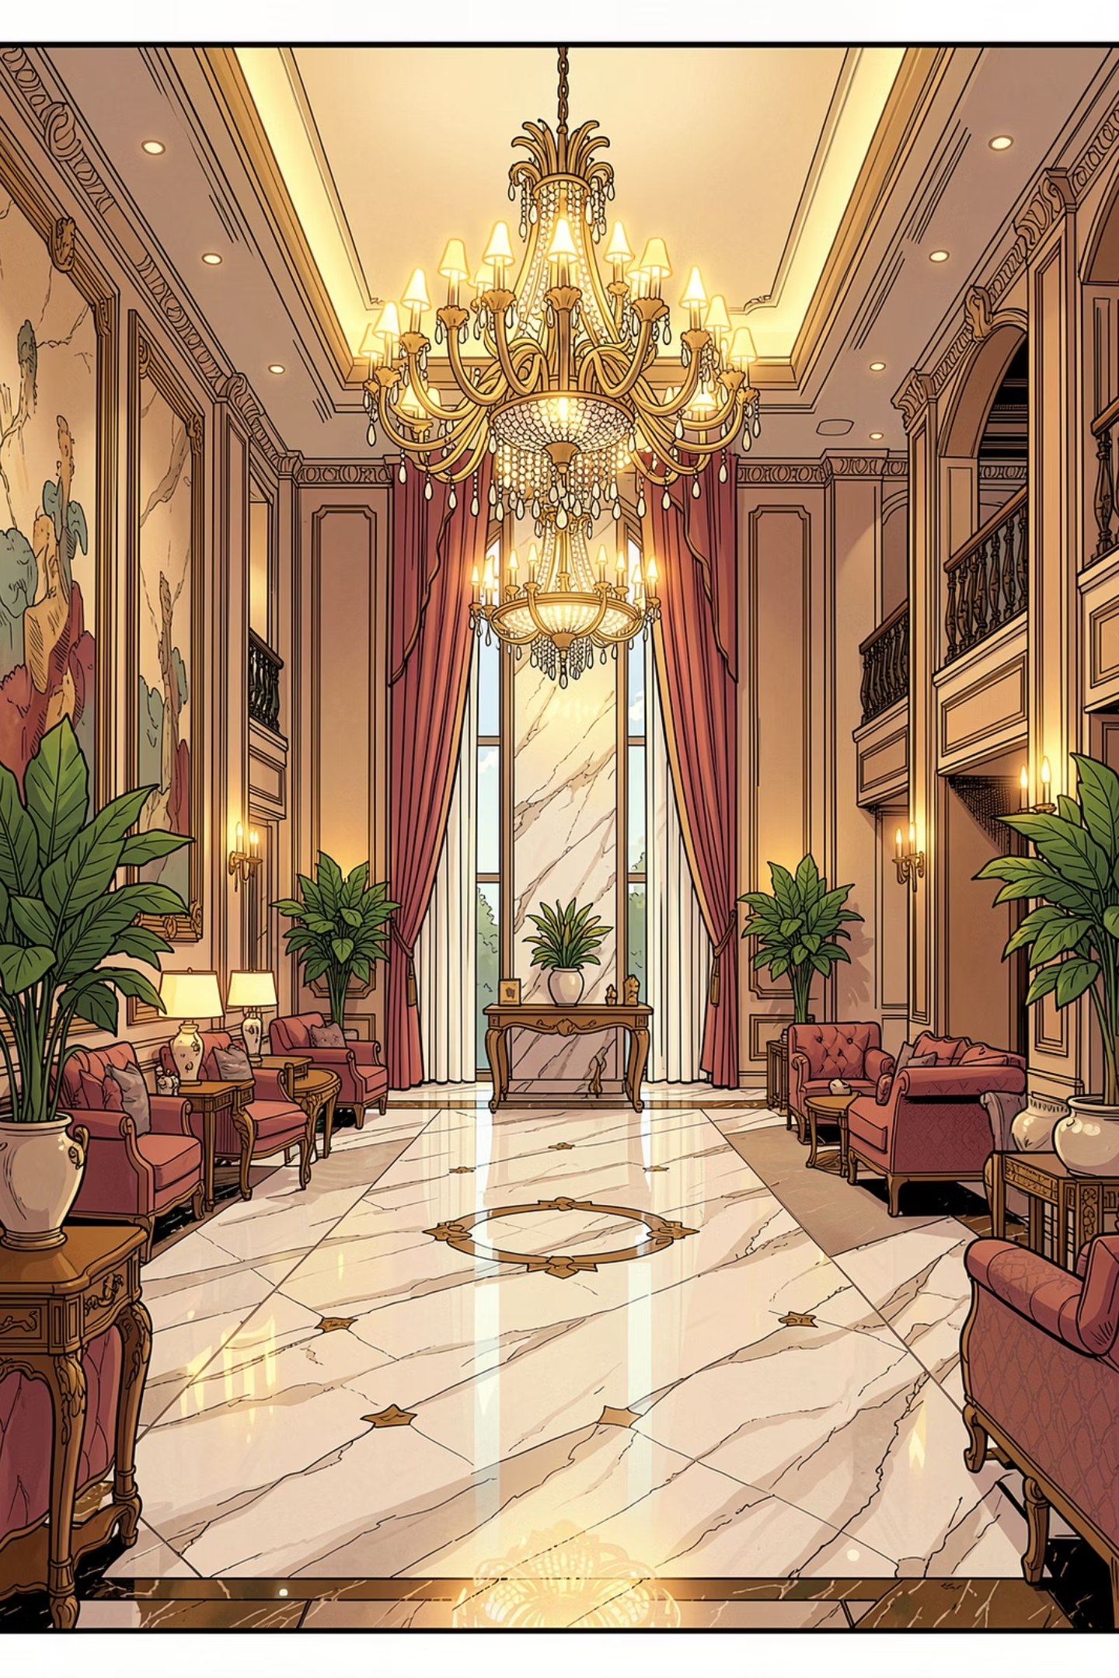




VALUE PROPOSITION
Value to Global Brands
We eliminate the friction of entering India — delivering speed, protection, and accountability.
Single Point of Accountability
One trusted partner for all India operations.
Faster Market Penetration
Pre-vetted networks and regulatory expertise accelerate entry.
Lower Execution Risk
Rigorous due diligence and structured governance frameworks.
Enhanced Brand Protection
Proactive monitoring and corrective action protocols.

Slide 16
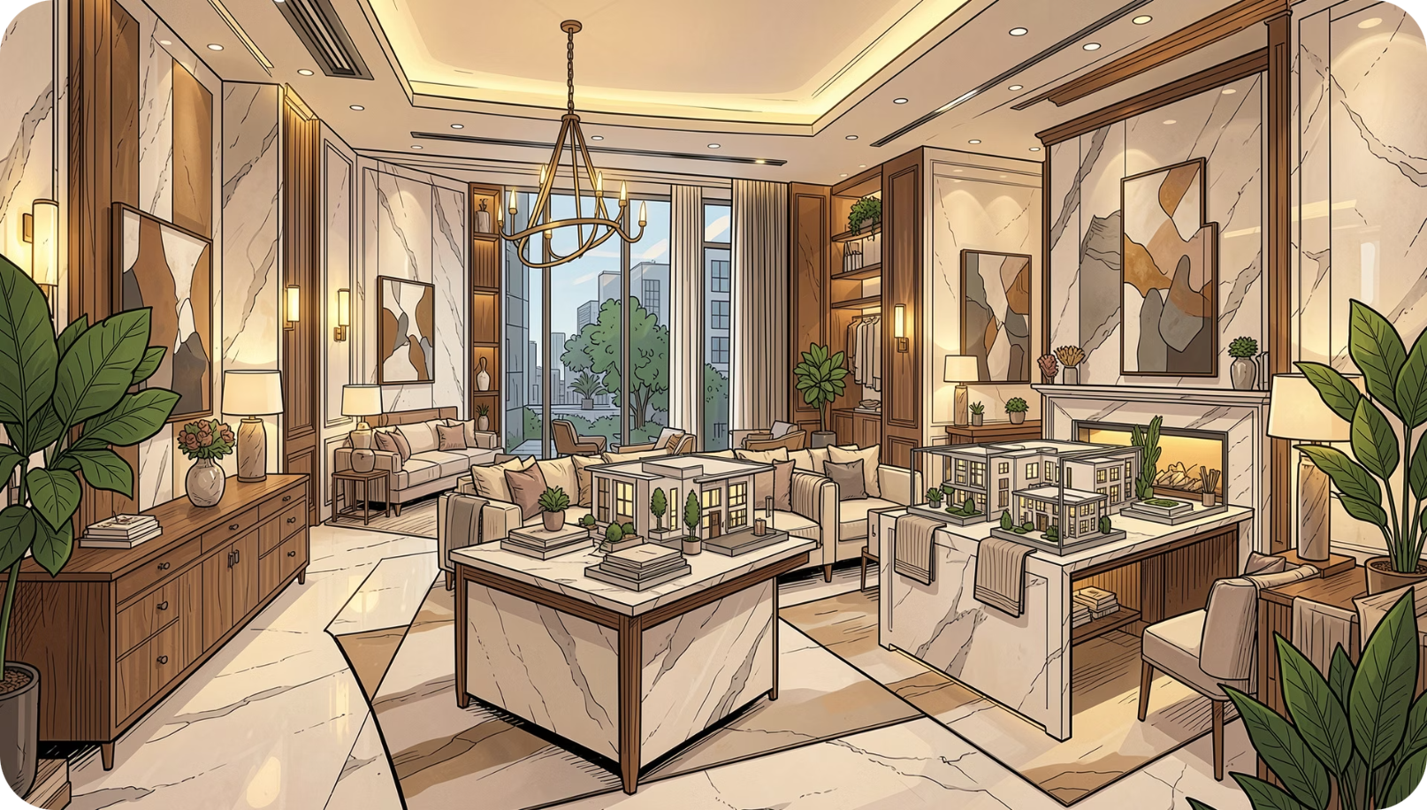
VALUE PROPOSITION
Value to Developers
For Indian developers, a global brand partnership is a powerful commercial lever — transforming a standard project into a differentiated, premium asset.
Access to Global Brands
Differentiated Positioning
Direct introductions to brands otherwise inaccessible.
Brand affiliation elevates project perception and desirability.
Pricing Premium & Sales Velocity
Institutional Credibility
Branded projects command 15–30% price premiums and sell faster.
Brand association strengthens investor and lender confidence.

Slide 17
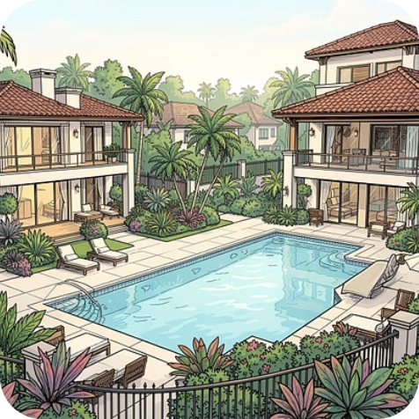
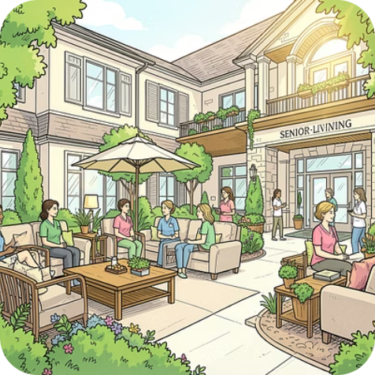

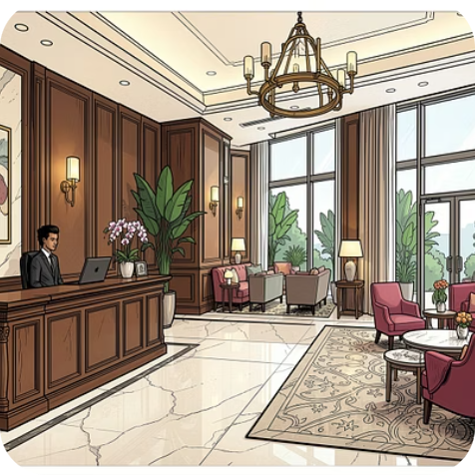
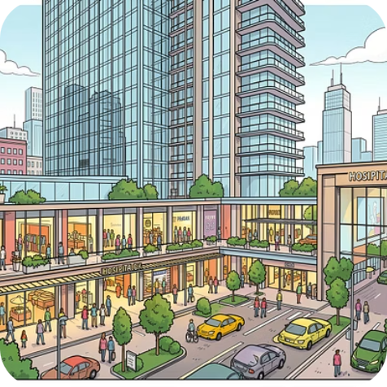
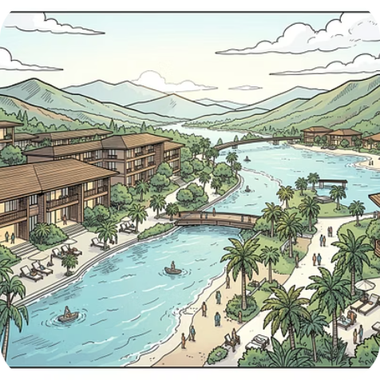
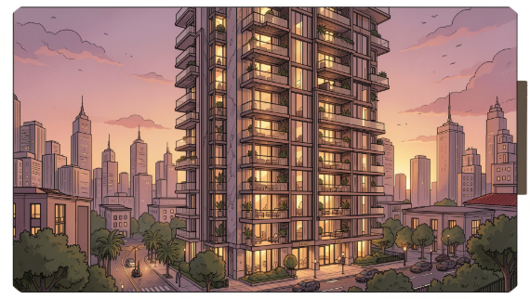
MARKET FOCUS
Target Sectors
High-growth asset classes where branded positioning commands premium valuations and accelerates sales velocity.
1
Branded Residences
2
Luxury Villas
3
Senior Living
Exclusive gated communities with branded lifestyle curation.
Premium assisted living with hospitality-grade services.
Luxury apartments under globally recognised brand flags.
4
Wellness Communities
5
Serviced Residences
6
Hotels & Mixed Use
Holistic lifestyle destinations anchored by wellness brands.
Hotel-managed apartments for long-stay luxury living.
Integrated developments combining hospitality, retail, and residences.
7
Destination Developments
Landmark projects in high-visibility leisure and tourism corridors.

Slide 18





THE TEAM
Why Raakesh & Team
Deep domain expertise across real estate, finance, operations, and strategic execution — with the relationships and credibility to connect international brands with Indian developers and investors.
Cross-Sector Experience
Global–India Bridge
End-to-End Execution
Professionally well qualified. 28 years proven track record across real estate development, financial structuring, and operational leadership in 8 different industries in complex Indian markets.
Unique ability to translate international brand standards into locally executable strategies, bridging cultural and regulatory gaps.
From first conversation to license signing and beyond — we stay engaged through delivery and governance.

Slide 19

COMMERCIAL FRAMEWORK
Business Model
Our fee architecture aligns incentives across the full project lifecycle — from market entry through ongoing brand governance — ensuring shared success between brands, developers, and our team.
Our fee structures are negotiable and tailored to the scale, complexity, and duration of each engagement.

Slide 20
BRAND PARTNERSHIPS
Target Brand Categories
We engage brands whose equity, design language, and aspirational value translate into premium real estate demand.
🏨 Luxury Hotels
👗 Fashion Brands
Five-star and ultra-luxury hospitality operators.
Haute couture and luxury lifestyle houses.
🏎️ Automotive Brands
🛋️ Interior & Design
Prestige automotive marques with lifestyle extensions.
World-class design studios and furniture brands.
🧘 Wellness Brands
⚽ Sports & Entertainment
Global wellness, spa, and fitness operators.
Iconic sports franchises and entertainment brands.

Slide 21
BRAND PARTNERSHIPS
Target Brand Categories
We engage brands whose equity, design language, and aspirational value translate into premium real estate demand.
🏨 Luxury Hotels
👗 Fashion Brands
Five-star and ultra-luxury hospitality operators.
Haute couture and luxury lifestyle houses.
🏎️ Automotive Brands
🛋️ Interior & Design
Prestige automotive marques with lifestyle extensions.
World-class design studios and furniture brands.
🧘 Wellness Brands
⚽ Sports & Entertainment
Global wellness, spa, and fitness operators.
Iconic sports franchises and entertainment brands.

Slide 22
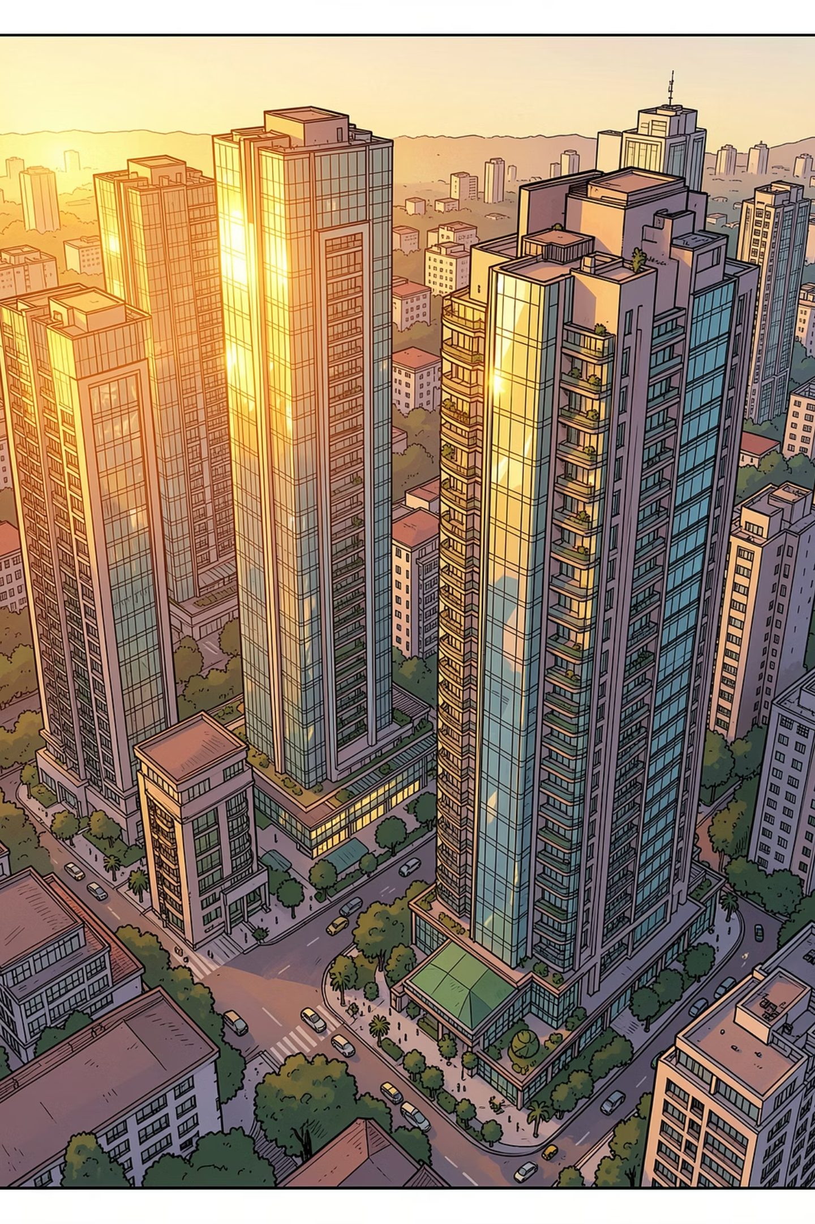
INDIA BRANDED RESIDENCES · INVESTMENT CASE
Beyond the Brochure: The Investment Case
Market size: India's branded residence market is currently valued at ₹20,000–25,000 crore
Growth rate: expanding at 18–20% CAGR
2030 projection: projected to exceed ₹45,000–60,000 crore by 2030
Mid-2030s projection: and cross ₹1 lakh crore by the mid-2030s
This is why global brands — Marriott, Four Seasons, ELIE SAAB, Tonino Lamborghini — are turning their attention to India.

Slide 23





MARKET REALITY
The Problem for Global Brands
India's complexity creates structural barriers that deter even the most experienced international brands.
1
2
Fragmented Developers
Regulatory Complexity
No consolidated ecosystem of credible, brand-ready partners.
Multi-layered compliance across central, state, and local authorities.
3
4
Inconsistent Execution
Limited Local Oversight
Quality and delivery standards vary widely, risking brand equity.
Global brands lack on-ground presence for real-time governance.

